Slide 1

CARBONLENS : Data Analysis of Global CO2 Emission
PRODUCT CLUB , IIT KANPUR
MENTORS:
1. SANKET BANSAL
2. ADNAN KHAN
3. MUKUND SINGHAL
FROM RAW DATA OF CO2 TO INDEPTH
ANALYSIS OF GLOBAL CO2 EMISSION

Slide 2
TABLE OF CONTENTS
01
PROJECT DESCRIPTION
j
02
WEEKWISE LEARINGS AND RESOURCES
03
INSIGHTS AND ANALYSIS
04
OBSERVATION AND PRECAUTIONS
05
LINKS AND TEAM MEMBERS

Slide 3
PROJECT DESCRIPTION
OVERVIEW AND OBJECTIVE:
The project focuses to enhance the practical skills in analyzing climate data, focusing on global carbon emission . Over six weeks we explored data cleaning , manipulation , and visualization using SQL , Python , Numpy , Pandas and Tableua/Power BI. We learned to interpret data patterns , generate actionable insights , and present finding using graphs , charts and plots. By the end of this project , we are able to analyse carbon emission effectively and provide data-driven recommendations for environmental sustainability.

Slide 4
PROJECT DESCRIPTION
PROJECT TIMELINE:
LEARNING OF BASICS OF PYTHON AND SYNTAX AND SOLVING SOME CODING PROBLEMS
SQL FOR DATA CLEANING AND SUMMARIZATION
FINAL REPORT AND PRESENTATION
01
03
05
00
02
04
UNDERSTANDING THE PROBLEM+EXPLORING THE DATASET
LEARNING BASICS OF NUMPY , PANDAS , MATPLOTLIB TO MANIPULATE AND VISUALISE THE DATA
TABLEAU/POWER BI , DATA VISUALISATION , INSIGHTS GENERATION AND RECOMMENDATIONS

Slide 5
WEEKWISE LEARNING AND RESOURCES
GIVEN A BRIEF OVERVIEW OF THE PROJECT & LEARNED HOW TO ANALYSIS A RAW DATA , ALSO ANALYSE THE EACH COLUMNS OF RAW DATA TABLE AND MADE A DOCUMENT OF DETAILED MEANING OF EACH COLUMN HEADING
Link : Columns_raw_data
WEEK 0
LEARNED BASICS OF PYTHON AND PRACTICED SOME QUESTIONS OF PYTHON FOR BEING FAMILIAR WITH THE SYNTAX AND LOGIC BUILDING AND CODE WRITING IN PYTHON
Link : python_for_beginners
WEEK 1

Slide 6
WEEKWISE LEARNING AND RESOURCES
LEARNED BASICS OF NUMPY , PANDAS , MATPLOTLIB etc. TO UNDERSTAND HOW DATA ANALYSIS WORKS AND HOW TO DRAW INSIGHTS FROM A GIVEN DATASET AND VISUALISE IT BY GRAPGHS AND CHARTS
Link : numpy_pandas_matplotlib
WEEK 2
LEARNED SQL BASICS AND HOW TO WORK ON A RAW DATA AND USING NUMPY , PANDAS , SQL MANIPULATE THE DATA AND CLEAN THE RAW DATA AND ALSO CLEANED THE RAW DATA GIVEN TO US
Link : SQL_basics
WEEK 3

Slide 7
WEEKWISE LEARNING AND RESOURCES
LEARNED ABOUT BASICS TABLEUA AND POWER BI AND ALSO VISUALISE THE CLEANED DATA BY MAKING DIFFERENT TYPES OF GRAPHS , PLOTS AND CHARTS USING MATPLOTLIB , TABLEUA AND POWER BI
Link1 : Tableua_basics
Link2 : Power_BI_basics
WEEK 4
USING ALL THE CHARTS , PLOTS , GRAPHS DRAW INSIGHTS ABOUT THE GLOBAL CO2 EMISSION AND TRY TO FIND OUT THE REASONS AND SOLUTIONS AND MAKE THIS PRESENTATION
Link : Carbonlens_presentation
WEEK 5

Slide 8
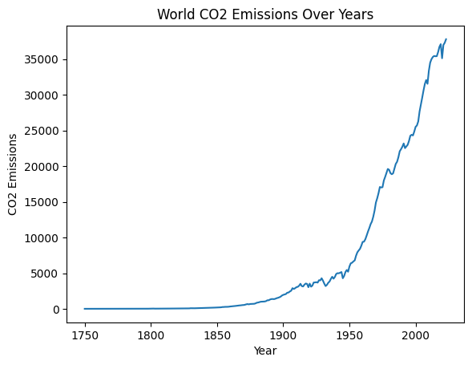
INSIGHTS AND ANALYSIS
YEARWISE GLOBAL CO2 EMISSION:
Here we can observe from the graph given
that as the year increases ,the population
also increases , for that we need more
resources , so cutting of trees ,industrial development,
land usage , vehicles increases rapidly. These are the sources of
emission of CO2.
In the next segment we will see the effect of global population on the emission of CO2.

Slide 9
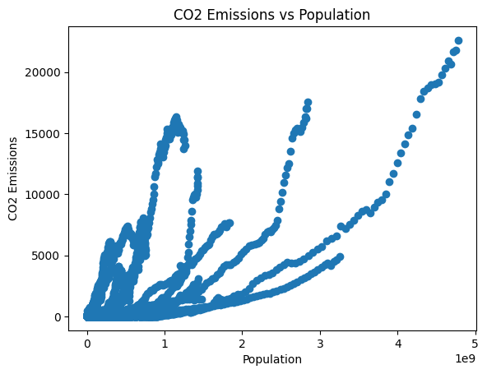
INSIGHTS AND ANALYSIS
POPULATION VS CO2 EMISSION:
Though the graph given here is not much
beautiful, but we can observe that as the
global population increases , the need of
human beings also increases. So , to fulfill the needs of humans , industrial
revolution , vehicles, oil-coal factories and many more .
These are the main sources of CO2 as well as many other toxic gases like
carbon mono-oxide, Sulphur di-oxide, Nitrous Oxide etc. This causes Global
warming , acid raining and many dangerous diseases like lung cancer.

Slide 10
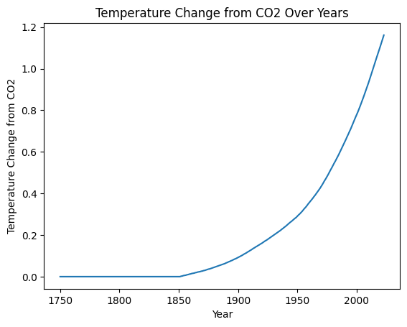
INSIGHTS AND ANALYSIS
CHANGE IN TEMPERATURE DUE TO CO2 :
From the given figure , we can clearly see that
as year increases , the temperature also increases.
Also in the previous section , with years the
emission of CO2 also increases. So, from these data
we can observe that carbon dioxide plays a major
role in global warming. As the time passes , the
global temperature also increases. As a result, the polar ice melts rapidly.
This increases the sea levels . So, many low areas and islands are going inside the
sea. This may also lead to climate change , species extinction also flood and
tsunami like disasters

Slide 11
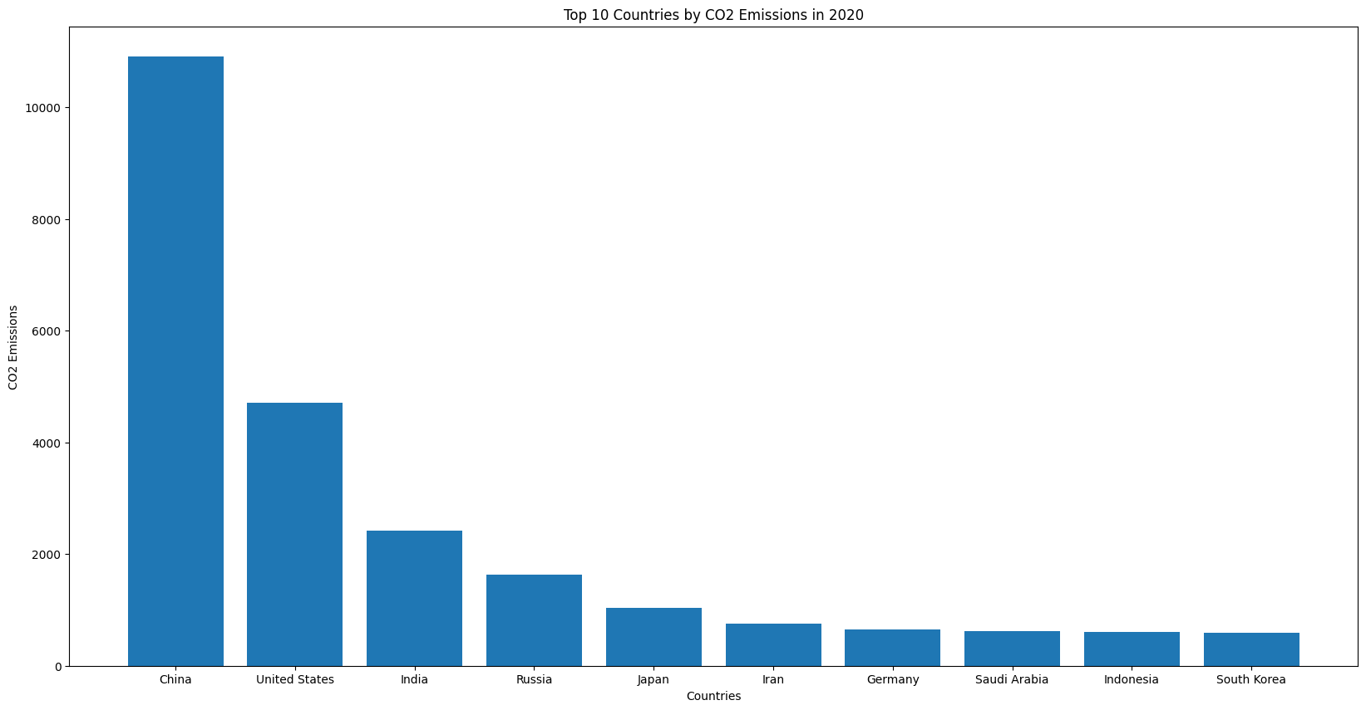
INSIGHTS AND ANALYSIS
ADVANCEMENT OF CIVILIZATION:
Here , if we see the data analytics given
, we notice that CHINA , USA , INDIA ,
RUSSIA and others are the world’s top
advanced countries . Also their contribution
in the global CO2 emission is also high.
In these countries, due to advanced technology there is a very good amount
of industries and energy consumption. And the main source of energy is coal.
And burning of coal leads to emission of CO2 in the atmosphere.
We will try to discuss the solution of the problem in upcoming slides

Slide 12
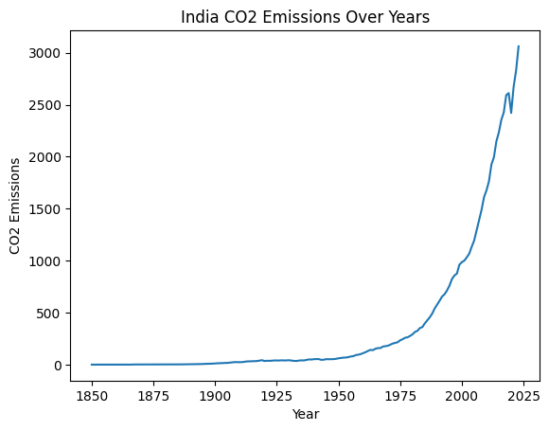
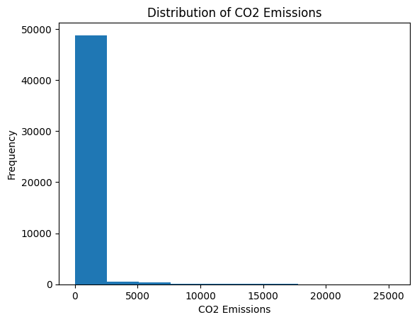
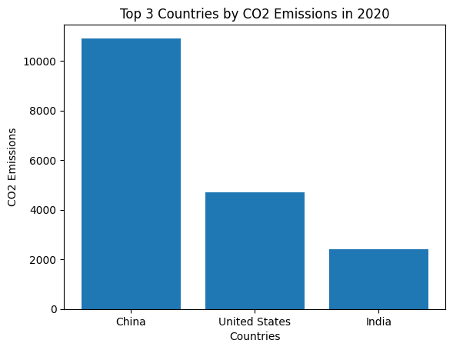
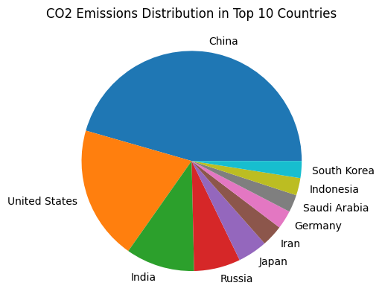
INSIGHTS AND ANALYSIS
OTHER GRAPHS WE CAN REFER:

Slide 13
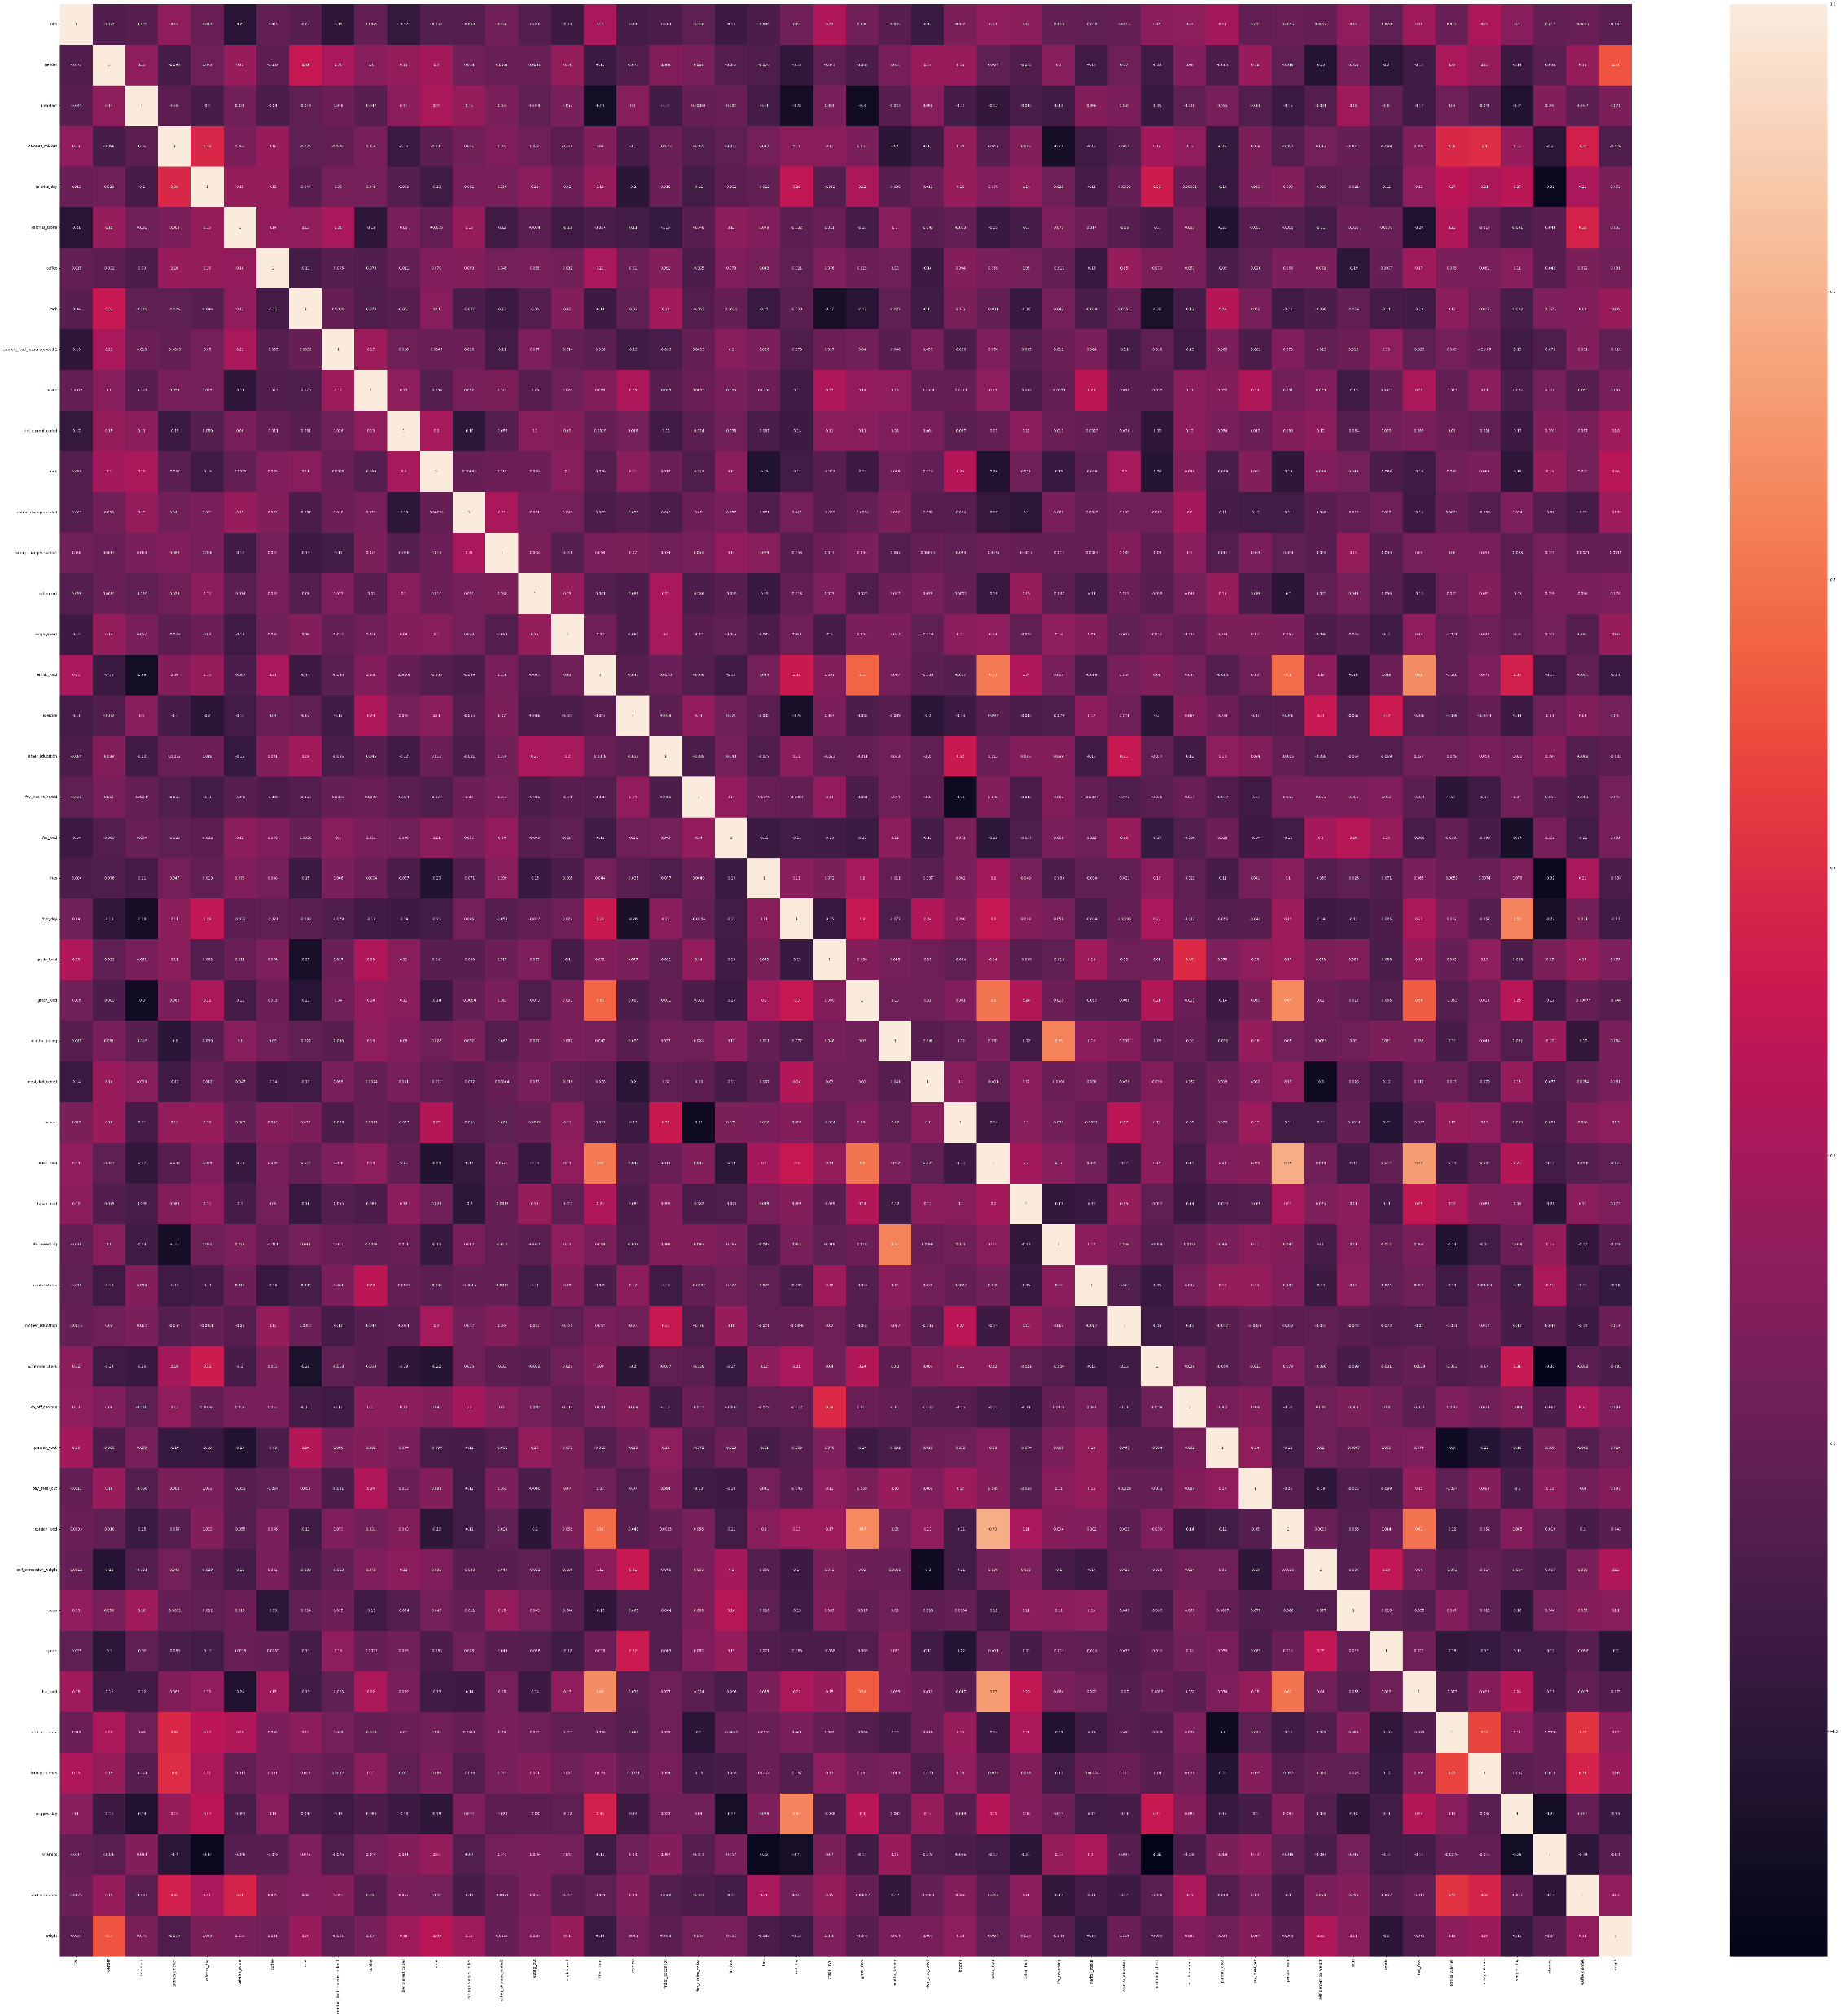
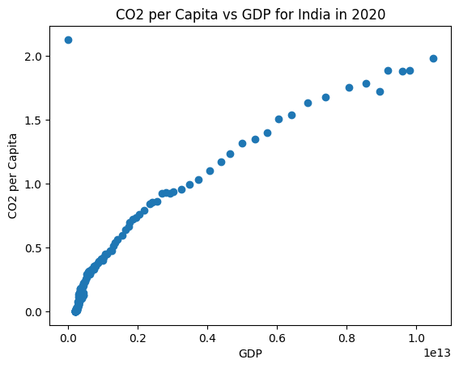
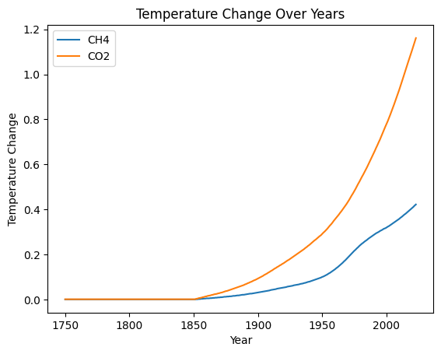
INSIGHTS AND ANALYSIS
OTHER GRAPHS WE CAN REFER:

Slide 14
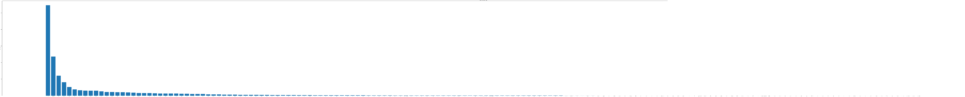
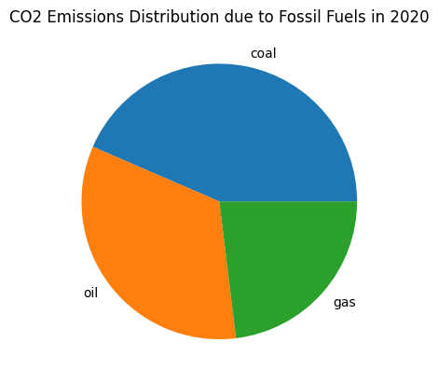
INSIGHTS AND ANALYSIS
OTHER GRAPHS WE CAN REFER:

Slide 15
OBSERVATION AND PRECAUTION
OBSERVATION SUMMARY:
From the above analysis, we can clearly say that as time passes , the emission of CO2 increases rapidly(exponentially). And the main cause behind this brutal act to nature is HUMAN. We are basically destroying the nature. More emission of CO2 leads to global warming , flood , air pollution , temperature rise and due to events , species extinction , climate change , heavy rainfall(Due to which many areas flood) , polar ice melt , sea-level rise and ultimately destruction of ecosystem. We should remember that we all part of nature , so we should not waste this resources. Also the air pollution due to the coal burn leads to many diseases like Bronchitis , Asthma , lung cancer and many more lung diseases which may ultimately lead to complete destruction of HUMAN species

Slide 16
OBSERVATION AND PRECAUTION
PRECAUTION:
First of all , we should stop uncontrolled tree cutting. We know that we need the resources of trees for food , furnitures , medicines and many more things. But besides cutting a tree , we should plant atleast three saplings to maintain the ecological balance of nature and this may also reduce the emission of CO2 and other poisonous gases like carbon mono-oxide , nitrous oxide etc. by absorbtion and reduces their impacts on nature.
Again we mention that advancement of civilization leads to emission of CO2 in nature. But then SHOULD WE STOP ADVANCING OUR TECHNOLOGIES ? The answer is NO. We must not stop. Rather we should find alternatives. One of the alternatives we think is SUSTAINABLE USAGE OF RESOURCES AND DEVELOPMENT . We all know that in the present time how much energy we should need in our daily life. That is huge. The major part comes from the coal. We should make alternatives like Atomic power , wind power , solar energy , hydroelectric power. Also we should recycle the wastes. And at the end , the only thing we need TO THINK ABOUT NATURE IN A DIFFERENT WAY that is SUSTAINABLY ……

Slide 17
LINKS AND TEAM MEMBERS
LINKS:
1. RAW DATASET : Raw_dataset_co2
2. CLEANED DATASET : Cleaned_dataset_co2
3.GRAPHS & PYTHON FILES : python_resources

Slide 18
LINKS AND TEAM MEMBERS
TEAM MEMBERS:
ANUJ SINGH
AYUSHI SHARMA
VAIBHAV GUPTA
CHANDRADIP KARMAKAR
SALONI KUMARI
AMAN AGARWAL
AADITYA MUKHERJEE
INENI SREE CHARAN
ATHARV DUBEY

Slide 19
PRODUCT CLUB , IIT KANPUR
THANK YOU
HOPE WE WILL AGAIN GET SUCH A BEAUTIFUL PROJECT IN THE UPCOMING SUMMER

